Slide 1





Smart Security & Gas Leak
Detection System
Smart Security System
Dash board (node red)
Gas Leak Detector
PIR Motion
MQ2 Gs Sensor
01

Slide 2
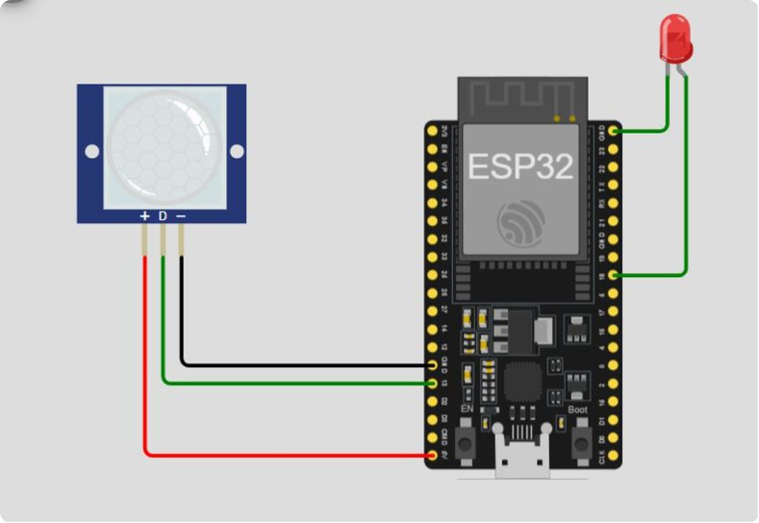


Components Used
The core hardware powering both detection systems
PIR Motion Sensor
Detects movement within the protected zone
Red LED
Visual indicator when motion is detected and the system is armed
ESP32 Microcontroller
Central control unit; connects all sensors to the network via Wi-Fi
SMART SECURITY & GAS LEAK DETECTION SYSTEM
03

Slide 3



System Overview
Two integrated systems operating over the MQTT protocol using Node-RED as a dashboard and control interface — enabling remote motion monitoring with alert control, and real-time gas leak detection with immediate response.
Motion Security System
PIR sensor detects motion and publishes "Motion Detected" to the broker
ARM / DISARM commands received remotely from the Node-RED dashboard
Alert activates only when the system is Armed and motion is detected
02

Slide 4
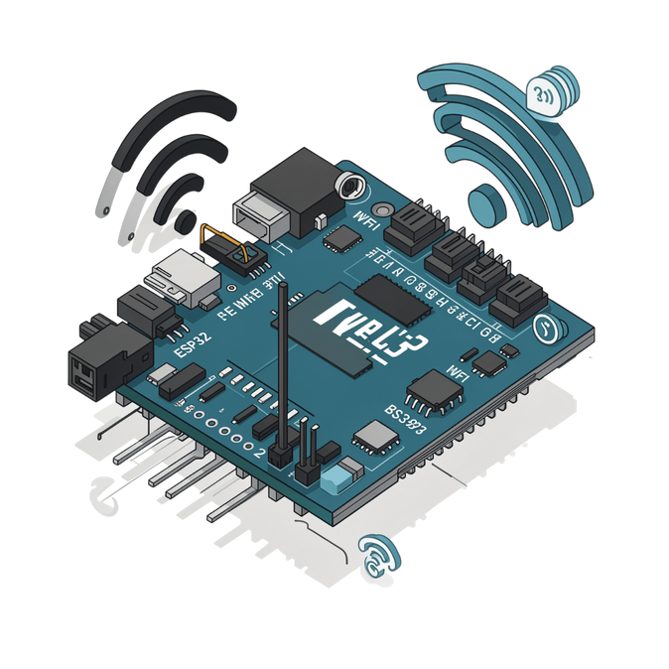
MQTT Protocol — Security System
The ESP32 acts simultaneously as a Subscriber (receiving ARM/DISARM commands from the Node-RED dashboard) and as a Publisher (broadcasting motion status and triggering the alarm), enabling real-time remote monitoring from anywhere.
Topic
Type
Action
Motion sensor/alarm
Publish
Arm/disarm
Motion sensor/status
Motion detected/system off/no motion detected
Subscribe
Motion sensor/info
Subscribe
the system armed /disarmed
04

Slide 5



Motion Detection Workflow
01
02
03
04
PIR Detects Motion
Publish Message
Status Check
Activate LED
Sensor is triggered — Motion Sensor Triggered
ESP32 publishes "Motion Detected" to the broker
System evaluates: Is the system Armed?
If Armed → LED turns ON as a visual alert
05
Remote Control via Dashboard
Operator sends ARM or DISARM command — Armed mode activates monitoring; Disarmed mode suppresses alarm even if motion is detected
05

Slide 6

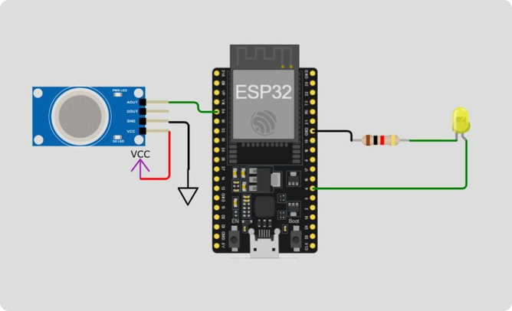
Gas Leak Detection Workflow
01
02
03
04
Read Gas Level
Publish Gas Level
Threshold Check
Alarm Activated
MQ2 sensor reads current gas concentration
ESP32 publishes the current gas percentage to the broker
System evaluates: Has the safe limit been exceeded?
If threshold exceeded → LED turns ON as a dual visual/audible alarm
Remote Alarm Reset
06

Slide 7
MQTT Protocol — Gas Leak Detector
Threshold Alert
No Manual Reset Required
When gas concentration exceeds the pre-defined value in the code 2000, the LED activates immediately as a dual visual and audible alarm
Full alarm control is handled remotely via the Dashboard, allowing monitoring and control from any internet-connected location
Topic
Type
Action
gas/value
Subscribe
current gas level
gas/alarm
Publish
System ON/OFF
gas/status
Gas leak detected/system safe/alarm disabled
Subscribe
07

Slide 8
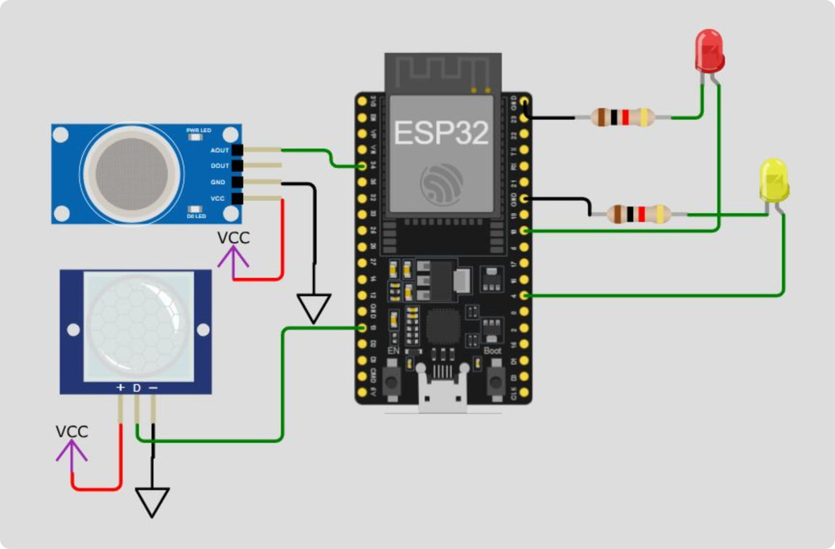
Combined Circuit Diagram
The full hardware setup connects the ESP32 microcontroller to both the MQ2 gas sensor and the PIR motion sensor, with two LED indicators (red and yellow) protected by resistors.
08

Slide 9

Full System Architecture
PIR Motion Sensor
Detects movement → publishes via MQTT → triggers Red LED alert
MQ2 Gas Sensor
Measures gas level → publishes via MQTT → triggers Yellow LED alarm
ESP32 Microcontroller
Central hub connecting all sensors to the network
Node-RED Dashboard (MQTT)
Routes all publish/subscribe messages between device and dashboard
Mobile App / Control Panel
Remote access to system status and controls from any device
09

